Slide 1
Email Data Analysis
Stanley Fok

Slide 2
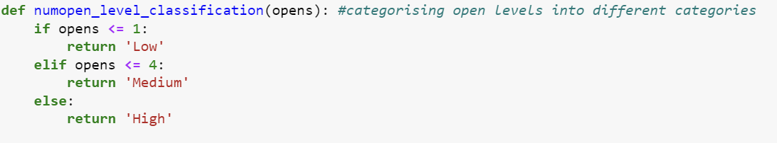
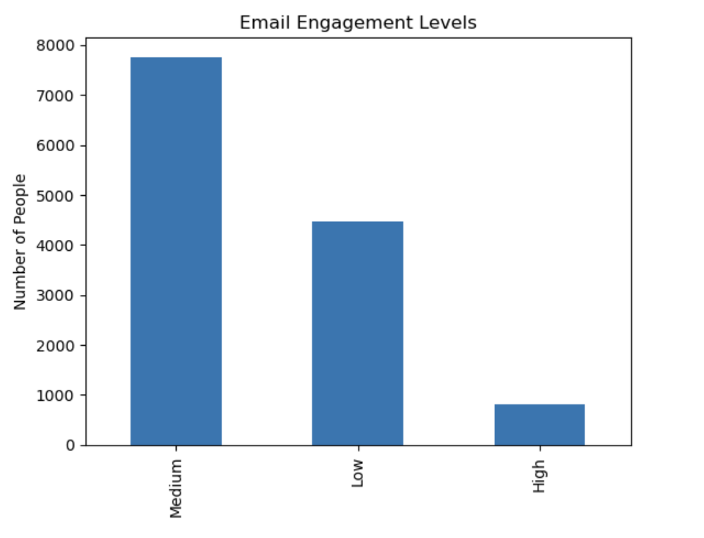
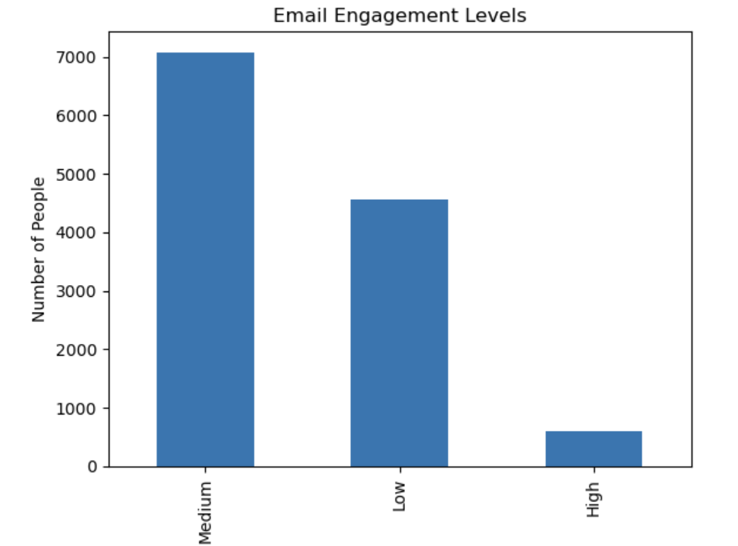
Engagement Levels per Number of People
Average Medium - 7,260
Average Low - 4,539
Average High - 624
Notes:
Number of opens peaks at medium
Increase average engagement level per person

Slide 3
2024
Average Medium - 7,260
Average Low - 4,416
Average High - 457

Slide 4
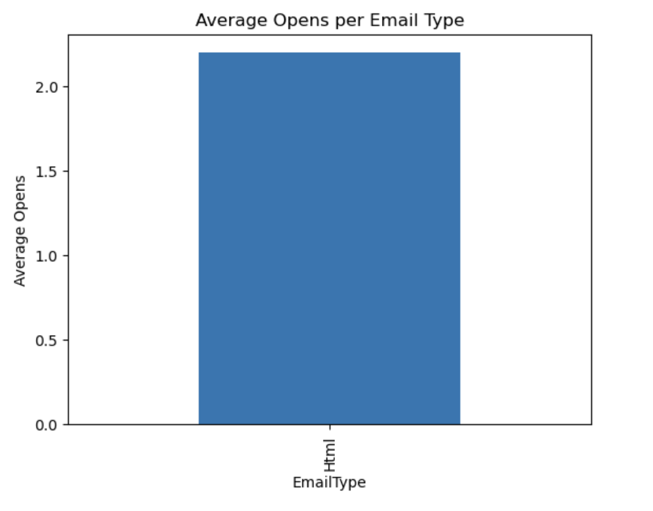
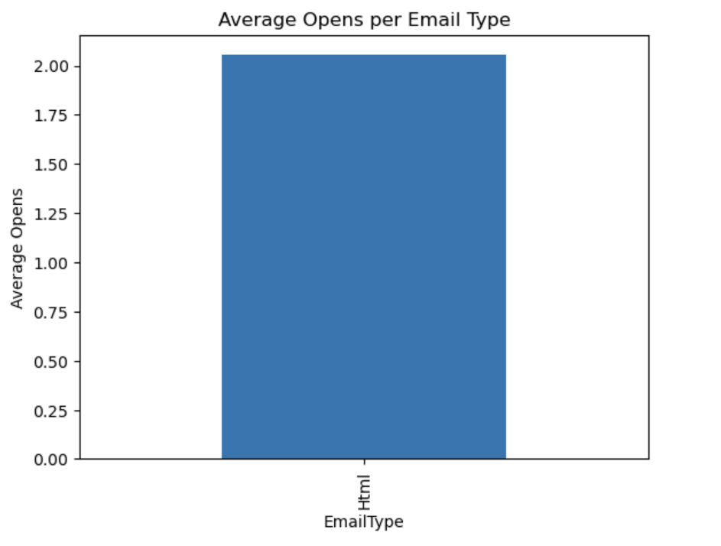
Average Email Opens
Average - 2.09 == 2
Notes:
Average opens per user (email)
Increase average email opens to be higher

Slide 5
2024
Average - 1.987 == 2

Slide 6
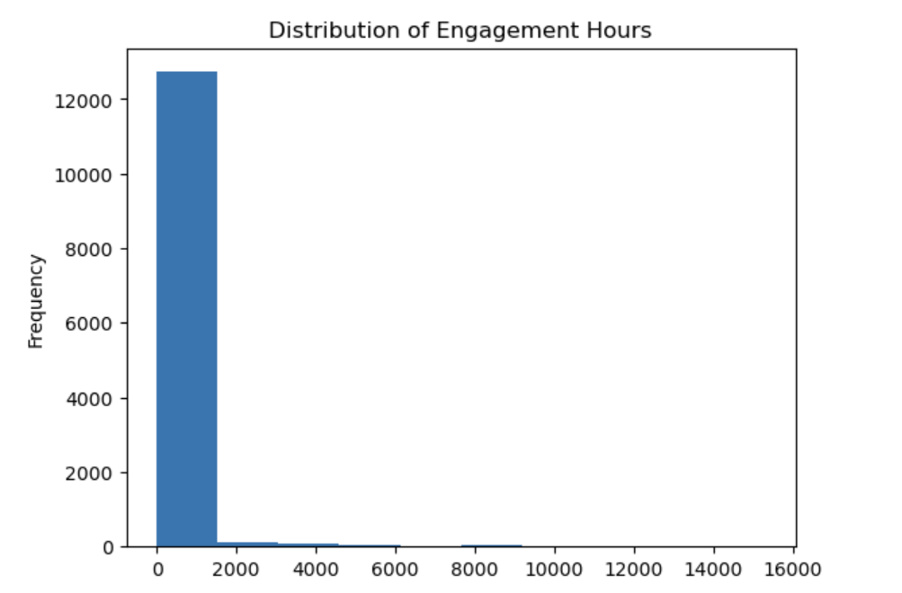
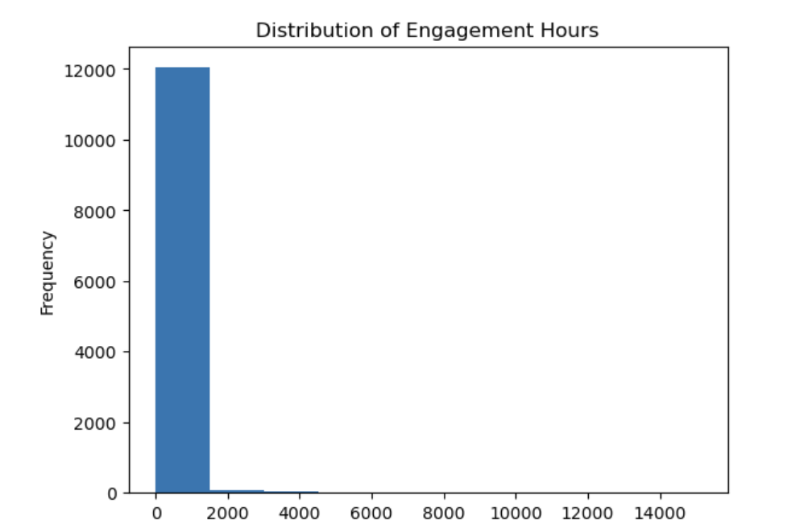
Distribution of Engagement Hours by Frequency
Average Highest - 12,175
Notes:
Normal and reasonable data count

Slide 7
2024
Average Highest - 11,876

Slide 8
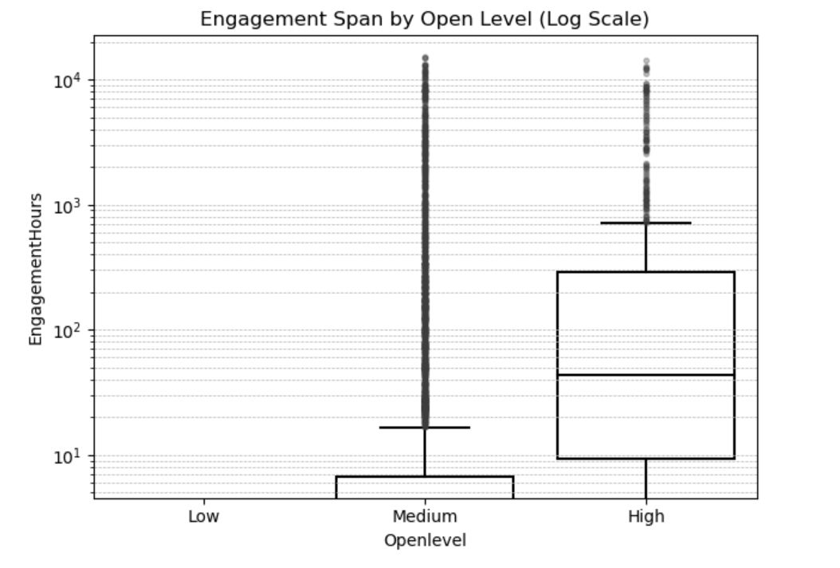
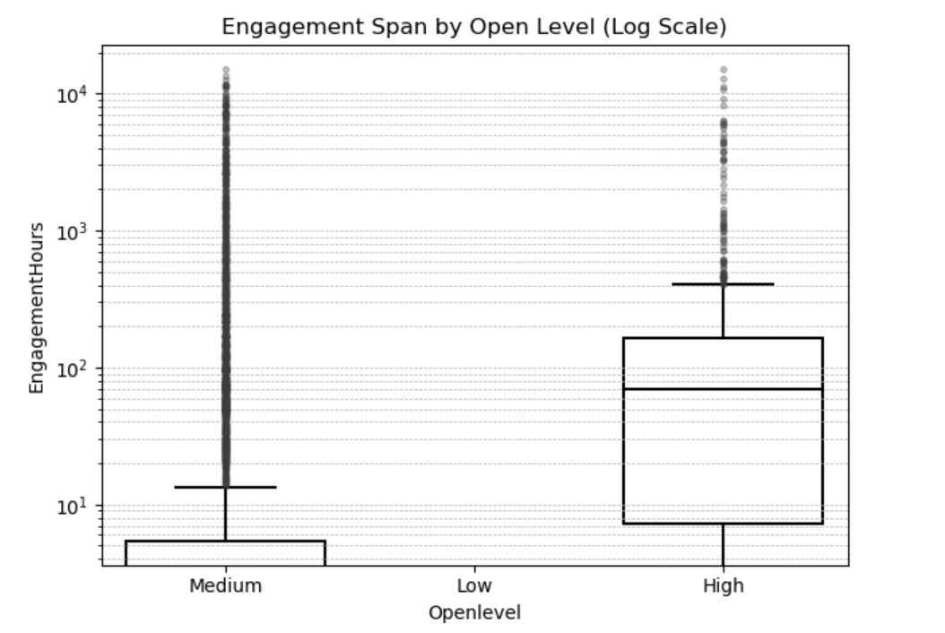
Engagement Span by Open Level
Median (Average) Engagement Span - High Open Level
Consistency - Medium > High
Outliers - Random Patterns
Notes:
Increase consistency levels to be higher

Slide 9
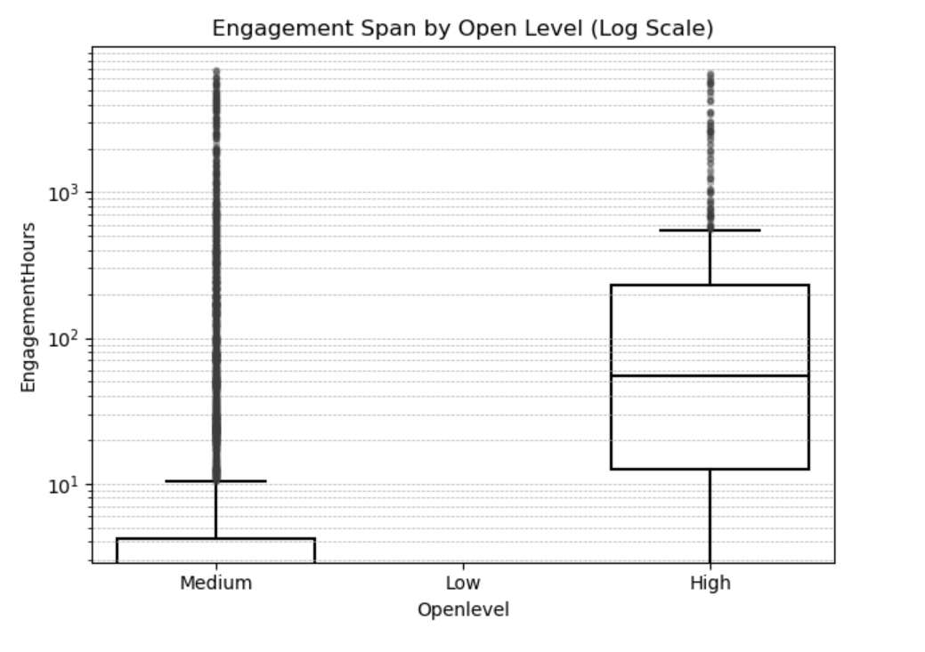
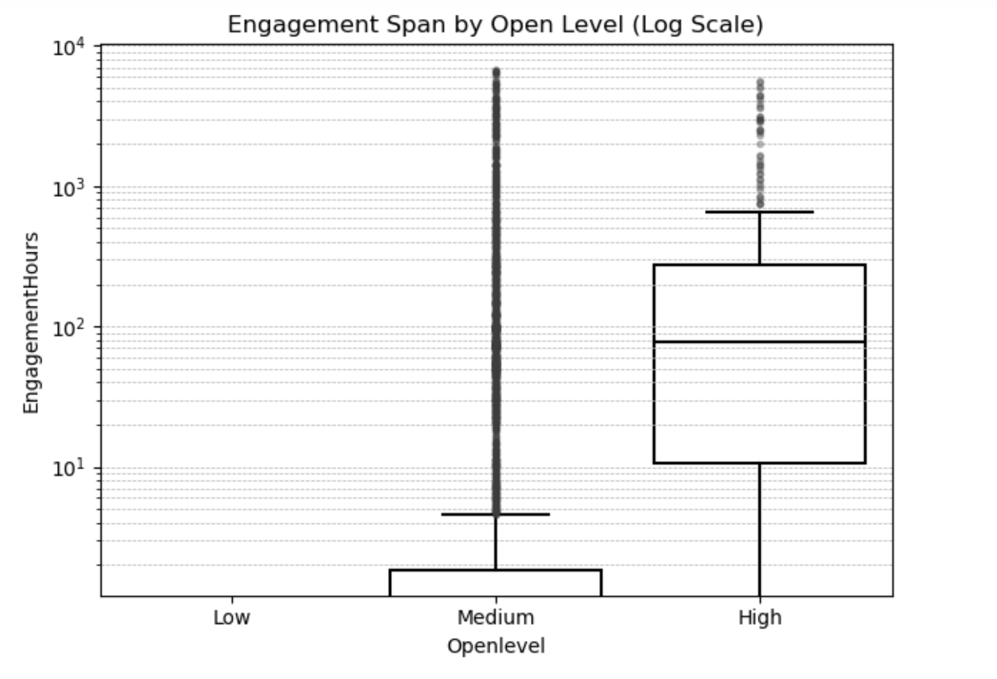
2024
Median (Average) Engagement Span - High Open Level
Consistency - Medium > High
Outliers - Random Patterns

Slide 10
Most and Least Clicked Link
https://le.ac.uk/study/welcome/events - 1983
https://www.leicesterunion.com/events/6013/4962/ - 555
https://www.leicesterunion.com/events/6013/4963/ - 428
https://www.leicesterunion.com/ents/event/4981/ - 243
https://www.leicesterunion.com/opportunities/societies/findasociety/ - 229
https://www.leicesterunion.com/ents/event/4978/ - 223
https://www.eventbrite.com/e/film-night-the-super-mario-bros-movie-tickets-703189066427?aff=odcleoeventsincollection&keep_tld=1 - 203
https://le.ac.uk/autumnfest - 75
https://le.ac.uk/black-history-month/events - 73

Slide 11
2024
https://le.ac.uk/study/welcome/events - 2,983
https://r1-app.dotdigital.com/analytics/reports/emailcampaigns/linkclicks/14669330?l=337226420 - 248
https://www.leicesterunion.com/whatson/ - 174
https://im-puzzled.com/ - 123
https://r1-app.dotdigital.com/analytics/reports/emailcampaigns/linkclicks/14669327?l=337061476 - 118
https://www.leicesterunion.com/ents/event/6362/ - 118

Slide 12
Recommendations
Redesign email wording, system, and display
Utilise drop-in locations on campus for university surveys
Create different welcome emails for student situation
Notes:
use more general terms for prizes, I'm not sure if everyone would be appealed to only food and drink vouchers.

